Slide 1


HOTEL
AGGREGATOR
ANALYSIS

Slide 2
OVERVIEW
The dataset comprises various attributes related to listings, hosts, reviews, and availability.
The objective is to create comprehensive visualizations and insights that shed light on trends, patterns, and factors influencing the performance of listings.
Through Power BI, interns will explore key metrics such as pricing, availability, host characteristics, and review scores to derive actionable insights for improving the overall quality and competitiveness of the listings.

Slide 3


DATASET DESCRIPTION
1. id: Unique identifier for each listing.
2. listing_url: URL of the listing on the hotel aggregator platform.
3. scrape_id: Identifier for the data scraping event.
4. last_scraped: Date of the last data scrape.
5. source: Source of the listing information.
6. name: Name of the listing.
7. description: Description of the listing.
8. neighborhood_overview: Overview of the neighborhood where the listing is located.
9. picture_url: URL of the listing's picture.
10. host_id: Unique identifier for the host.
11. ... (and many more columns capturing details about hosts, location, property type, room details,
amenities, pricing, availability, reviews, and other relevant information)

Slide 4


PROJECT OBJECTIVES:
01
Geographical Insights
02
Pricing and Availability Analysis
03
Host Performance
04
Review Scores and Guest Satisfaction

Slide 5
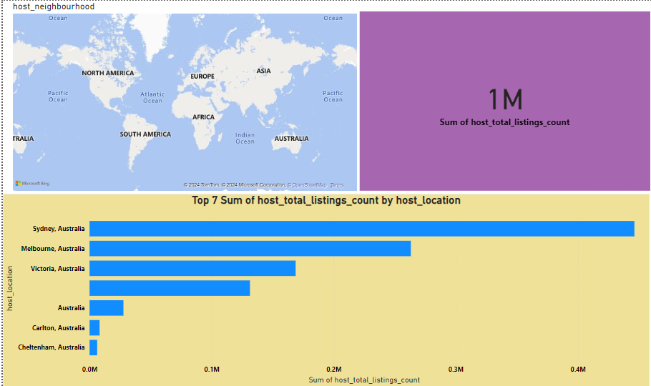
GEOGRAPHICAL INSIGHTS
- Visualize the distribution of listings on a map to identify popular neighborhoods.
- Explore the geographical concentration of listings and host locations.

Slide 6

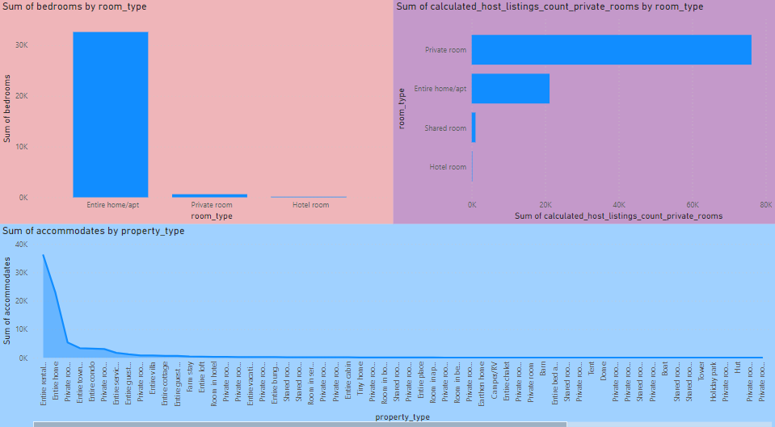
PRICING AND AVAILABILITY ANALYSIS
- Analyze pricing trends based on property types, room types, and accommodation capacity.
- Investigate the availability of listings over time and identify peak periods.

Slide 7
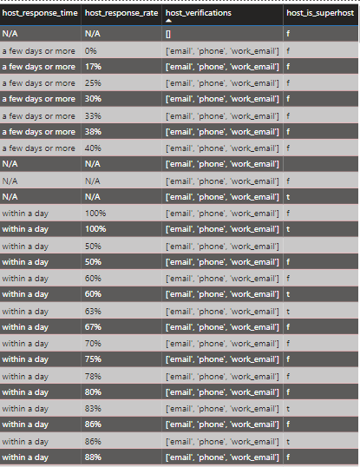

HOST PERFORMANCE
- Evaluate host characteristics, including superhost status, response times, and verification methods.
- Explore correlations between host attributes and listing performance.

Slide 8

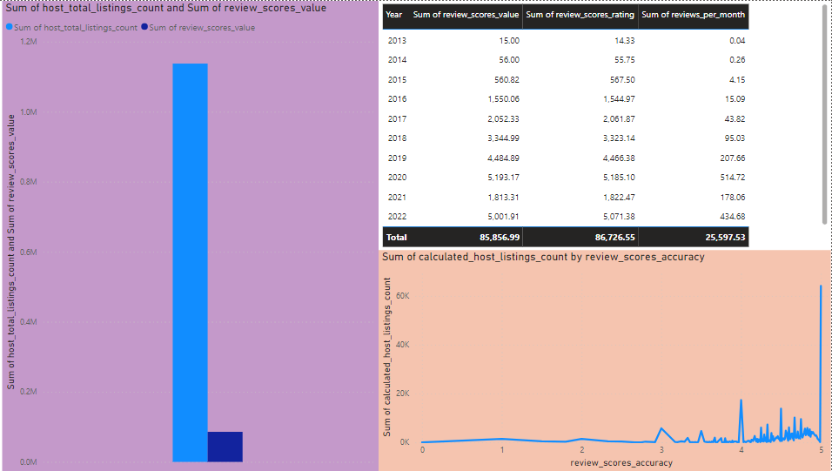
REVIEW SCORES AND GUEST SATISFACTION
- Examine review scores and their impact on overall listing performance.
- Identify areas for improvement based on specific review categories.

Slide 9
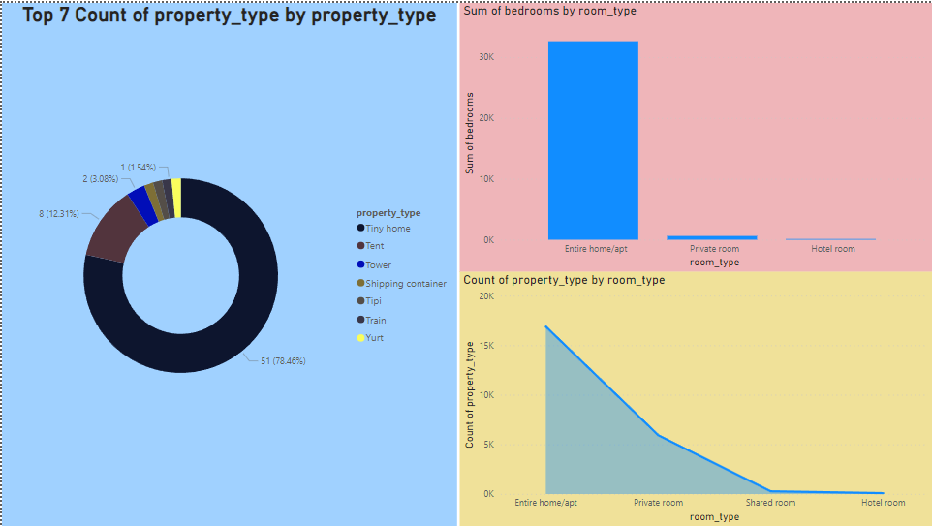

PROPERTY TYPE AND ROOM ANALYSIS
- ANALYSE THE DISTRIBUTION OF PROPERTY TYPES AND ROOM TYPES.
- Explore trends in the popularity of specific accommodation setups.

Slide 10

ANALYSIS
Should develop targeted marketing strategies attract travelers interested in unique properties and entire rental units hightlighting the platform’s diverse offerings.
Private rooms and hotel rooms have less rooms compared to home.
Capacity of accommodation doesn't have a proportional relationship with the price.
There are more number of tiny homes than other homes.
There is a strong and clear proportional relationship between the count of total reviews and total listing count. Thus giving more opportunity for rating making host more popular.

Slide 11
Thank's For Watching

